Slide 1
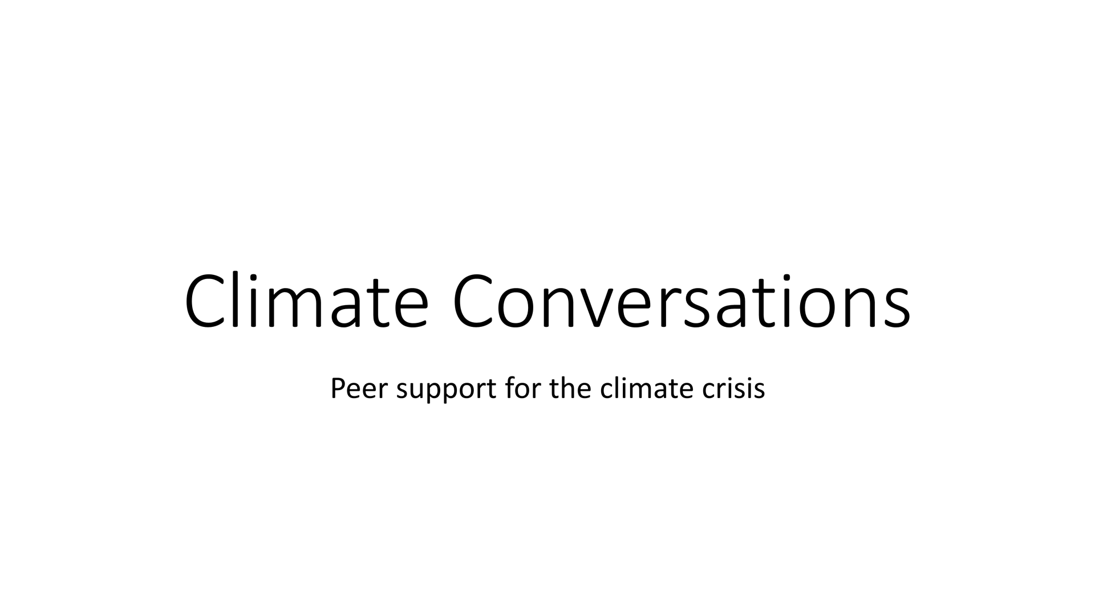

Slide 2
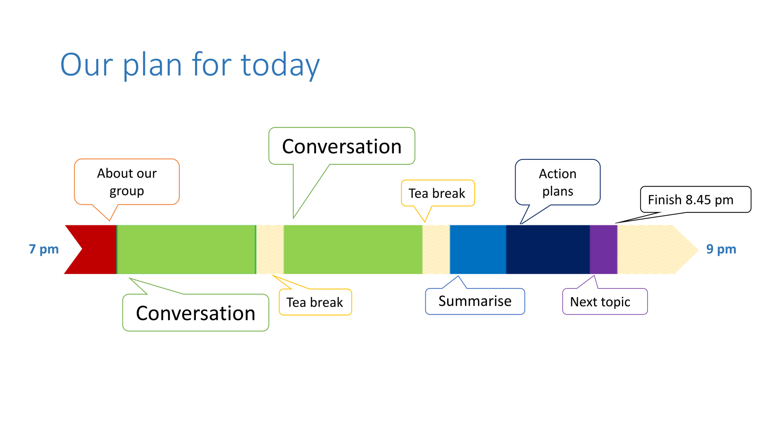

Slide 3
Our purpose
We believe that taking steps to engage with climate change is better than trying to avoid thinking about it. But figuring out how to respond to the climate crisis is hard.
Our meetings provide a space for us to work on this problem together. We can be honest about our questions, uncertainties, and difficulties. We can help each other process what’s happening and explore what we can do for ourselves and the planet.
"The end of the world as we know it, after all, is not something anyone should have to face on their own" Naomi Klein

Slide 4
Group agreement
Our group agreement:
We'll listen and give each other our full attention.
We avoid giving advice (unless we're asked to).
What we say stays in this room.
We arrive in time to participate in the whole conversation.
We stick to the topic.
Can you agree to this? Is there anything else you need?

Slide 5
Conversation
How can we make it more acceptable to talk about climate grief?

Slide 6
Background
At our last conversation we talked about how it is difficult to talk to other people about our grief.
Some people found grief and sadness made it harder to want to have conversations.

Slide 7
Why is it difficult to talk about loss, sadness and grief around the environment and climate change?
It's a taboo subject. There's a socially constructed silence.
People don't want to face it or don't know how.
We don't have a script or model for these conversations. We don't have ceremonies or rites to help us.
In our society we're not good at talking about grief or loss generally.
Climate grief can be ambiguous, intangible and disenfranchised. It makes it harder for people to react sensitively.

Slide 8
Social systems & structures
What makes it difficult to to talk about climate grief and loss?
Beliefs and values
Practical

Slide 9
What can we do to make it more acceptable to talk about climate grief, sorrow and loss?

Slide 10
Notes
The slides and notes we've made will be shared by email and on the website.
Is there anything you'd like removed or altered before we do that?
What do you think or feel at the end of today's conversation?

Slide 11
What shall we talk about next time?
Climate action
Including all kinds of work that moves us towards a sustainable world.
- Personal (values and beliefs)
- Practical (technology, behaviour, habits, practices)
- Social and political (systems, structures, networks and relationships)
- At home, work, in groups, and communities
Coping and Changing
Climate action
Grieving and other emotions
Including:
- Finding ways to tolerate distressing emotions.
- Exploring ways to grieve and process other emotions.
- Mental states like confusion, dissonance or shock.
Distancing & self-care
Grieving & other emotions
Distancing and self-care
Including:
- Making time for other things that are important in life.
- Denial and avoidance.
- Rest and taking care of ourselves.

Slide 12
Making changes
Action plans and other strategies

Slide 13
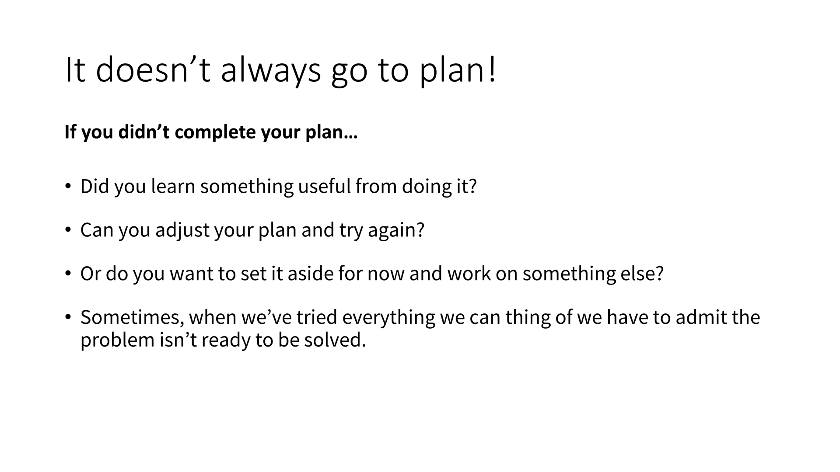

Slide 14
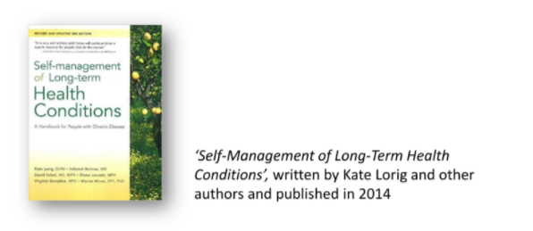
Writing an action plan
Identify your problem or goal.
Brainstorm ways of solving your problem or reaching your goal.
Choose one option to try over the next fortnight.
Write out exactly what you'll do. Be specific: what, when, where, how much.
Reality check. Is your plan realistic? If not adjust it.
How will you remember your plan?

Slide 15
Tool Box

Slide 16
The process of climate grief and anxiety
Waking up
Coping and changing
Living with the climate crisis
Shock
Climate action
Climate action
Adjustment & transformation
Distancing
(& self-care)
Grieving
(& other emotions)
Self-care
(& distancing)
More emotions
(& grieving)
Waking Up
Shock
Coping
Climate Action
Distancing
Grieving
Dissonance
Realisation
Isolation
Absurdity
Shock
Disorientation
Powerlessness
Anxiety
Depression
Tolerating distressing feelings
Self-compassion
Emotional regulation
Values and beliefs
Reflection
Conversation
Structures & systems
Interest groups
Lobbying & campaigning
Social movements
Ways of doing things
Behaviour change
Social practices
Technology
Organising
Avoidance
Denial
Distraction
Soothing
Ecological grief and sorrow
The four tasks of grieving:
Acceptance
Mourning
Adjusting to the new reality
Finding a path to action
More emotions
Changing
Self-care
Anger & outrage
Fear
Guilt
Hopelessness
Happiness & joy
Care & love
Envy & admiration
Resentment
Contentment & satisfaction
Belonging
Insignificance
Hope & inspiration
Our values & beliefs
Skills and capabilities
Finding meaning and purpose
Rest
Relaxation
Space for other things
Community care
Adapted from Dr Panu Pihkala's Process model of eco-anxiety and ecological grief (2022)

Slide 17
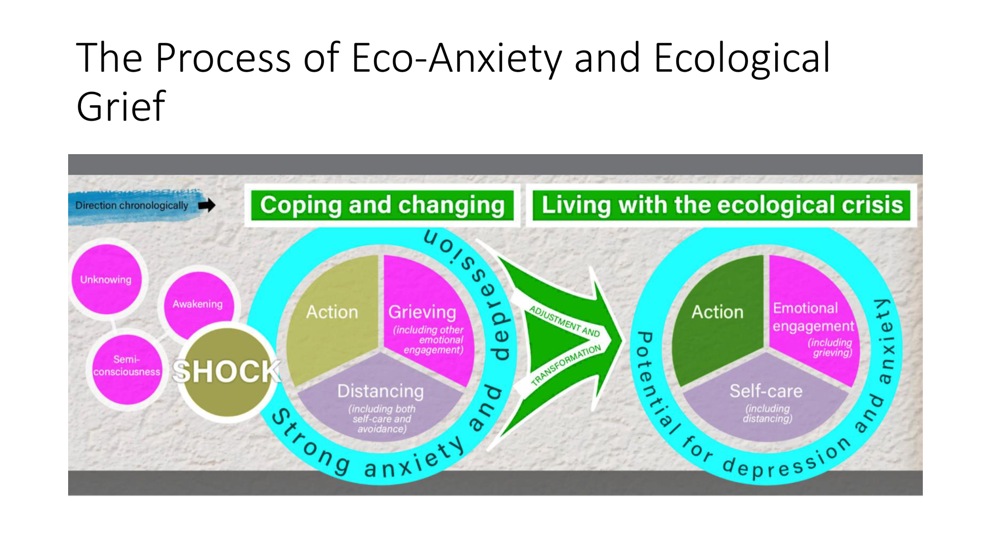

Slide 18
Three Spheres of Transformation
by Karen O'Brien
Selves
1. Values beliefs and worldviews
2. Systems and social structures
3. Practical
Social
Practical
Systems & structures
Values, beliefs
and worldviews

