Slide 1
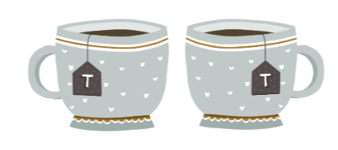
Climate Conversations
"The end of the world as we know it, after all, is not something anyone should have to face on their own" Naomi Klein

Slide 2
Our plan for today

Slide 3
Our purpose
We believe that taking steps to engage with climate change is better than trying to avoid thinking about it. But figuring out how to respond to the climate crisis is hard.
Our meetings provide a space for us to work on this problem together. We can be honest about our questions, uncertainties, and difficulties. We can help each other process what’s happening and explore what we can do for ourselves and the planet.

Slide 4
The process of eco-anxiety and ecological grief
Waking up
Coping and changing
Living with the climate crisis
Climate action
Climate action
Shock
Adjustment & transformation
Distancing
(& self-care)
Grieving
(& other emotions)
Self-care
(& distancing)
More emotions
(incl.grieving)
Journey.
Messy & complicated.
No one way to travel it.
Map.
Adapted from Dr Panu Pihkala's Process model of eco-anxiety and ecological grief (2022)

Slide 5
Group agreement
We'll listen and give each other our full attention.
We’ll avoid giving advice.
What we say stays in this room.
We’ll arrive in time to participate in the whole conversation.
We’ll stay on topic.
Can you agree to this?
Is there anything else you need today?

Slide 6
Conversation
Consumerism, the climate crisis and Christmas

Slide 7
Can you relate to the experience of conflicted or mixed feelings in the run-up to Christmas?
What are you feeling, and what comes to mind?

Slide 8
Notes
The slides and notes we've made will be shared by email and on the website.
Is there anything you'd like removed or altered before we do that?
What do you think or feel at the end of today's conversation?

Slide 9
What shall we talk about next time?

Slide 10
What shall we talk about next time?
The process of climate anxiety and ecological grief
Waking up
Coping & changing
Living with the climate crisis
Shock
Adjustment and transformation
Healthy coping and changing
Distancing and self-care
Includes:
Making time for other things that are important in life.
Denial and avoidance.
Rest and taking care of ourselves.
Climate action
Includes:
Daily life, activism, thought and reflection.
Three spheres of transformation:
Personal: values, beliefs, mindsets, worldviews and paradigms.
Social and political: social systems, networks and relationships, rules and regulations.
Practical: technology, behaviour and social practices.
Climate action
Grieving and other emotions
Includes:
Finding ways to tolerate distressing emotions.
Exploring ways to grieve and process other emotions.
Mental states like confusion, dissonance or shock.
Distancing & self-care
Grieving & other emotions

Slide 11
Making changes
Action plans and other strategies

Slide 13
Writing an action plan
Identify your problem or goal.
Brainstorm ways of solving your problem or reaching your goal.
Choose one option to try over the next fortnight.
Write out exactly what you'll do. Be specific: what, when, where, how much.
Reality check. Is your plan realistic? If not adjust it.
How will you remember your plan?

Slide 14
Tool Box
The process of eco-anxiety and ecological grief
Three Spheres of transformation
Leverage points for systems change

Slide 16
The process of climate grief and eco-anxiety
Waking up
Coping and changing
Living with the climate crisis
Shock
Climate action
Climate action
Adjustment & transformation
Distancing
(& self-care)
Grieving
(& other emotions)
Self-care
(& distancing)
More emotions
(& grieving)
Distancing
& self-care
Avoidance
Denial
Distraction
Soothing
Rest
Relaxation
Space for other things
Community care
Coping…
Shock
Tolerating distressing feelings
Compassion
Emotional regulation
Coping with change
Coping with uncertainty
Grieving
Isolation
Absurdity
Shock
Disorientation
Powerlessness
Anxiety
Depression
& more emotions
Waking
Ecological grief and sorrow
The four tasks of grieving:
Acceptance
Mourning
Adjusting to the new reality
Reengaging with life.
Anger & outrage
Fear
Guilt
Hopelessness
Happiness & joy
Care & love
Envy, admiration & resentment
Contentment, satisfaction
Belonging
Insignificance
Hope & inspiration
Dissonance
Realisation
… & changing
Our understandings
Skills and capabilities
Finding new meaning and purpose
Climate Action
Transforming values, beliefs, worldviews & paradigms
Reflection
Conversation
Personal and collective
Transforming structures & systems
Interest groups
Lobbying & campaigning
Social movements
Transforming ways of doing things
Behaviour
Social practices
Technology
Organising
Adapted from Dr Panu Pihkala's Process model of eco-anxiety and ecological grief (2022)

Slide 17
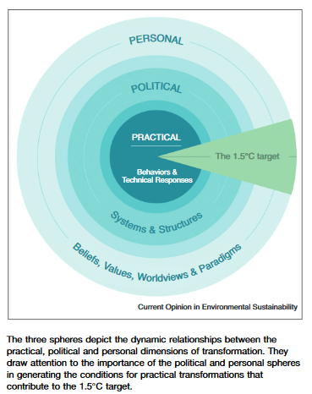
Three Spheres of transformation by Kate O’Brien
Personal transformation
What? Personal and collective beliefs, values, worldviews and paradigms.
How? Conversation and reflection.
Political transformation
What? Systems and structures.
How? Lobbying, interest groups, policy, rule changes, information and feedback flows.
Political transformation
What? Behaviour, technology, practices.
How? Specific actions, interventions, strategies.
O’Brien, Karen. “Is the 1.5°C Target Possible? Exploring the Three Spheres of Transformation.” Current Opinion in Environmental Sustainability, Sustainability governance and transformation 2018, 31 (April 1, 2018): 153–60. https://doi.org/10.1016/j.cosust.2018.04.010.

Slide 18
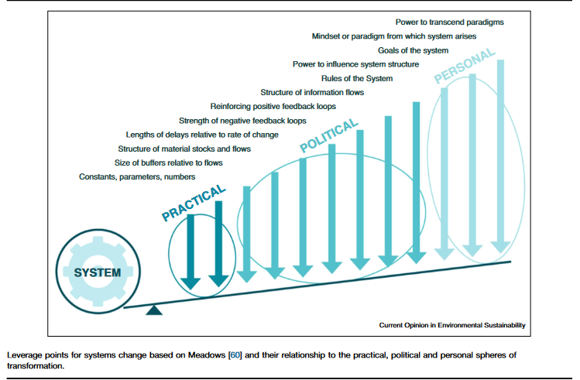
Leverage points for change
O’Brien, Karen. “Is the 1.5°C Target Possible? Exploring the Three Spheres of Transformation.” Current Opinion in Environmental Sustainability, Sustainability governance and transformation 2018, 31 (April 1, 2018): 153–60. https://doi.org/10.1016/j.cosust.2018.04.010.

